Slide 1

Melbourne as a Global Cultural Destination
Final Report (Summary)

Slide 2
Note to reader
The Melbourne as a Global Cultural Destination project focused on Melbourne, and areas within 5 km of the CBD
Across the project timeframe, BCG engaged with ~60 key Art Agencies CEOs/Board members and Thought Leaders across the sector, as well as running a series of idea generation workshops with Creative Victoria
On the basis of project findings, five strategic priorities have been recommended with an initial view of the actions within each priority, particularly with regards to improving the cultural offer
The following was agreed as outside the scope of this piece of work
Consideration of the regional creative and cultural offer
Analysis / or advice on initiatives which would be funded or managed by other parts of Government (e.g. affordable housing)
Detailed assessments of any of the individual investment proposals

Slide 3
Agenda
Executive Summary
Context
Performance Index
Assessing Melbourne against best practice
Cultural travellers and trends
Strategic priorities
Next steps

Slide 4
Executive Summary (1/3)
Melbourne has a compelling creative and cultural offer; the city attracted >10m Australian and international visitors in 2015
Diverse offer: fast-growing NGV, ACMI and Arts Centre; Museum Victoria attracting 3x the audience of the National Museum of Australia; highest concentration of commercial galleries in Australia; country's leading commercial theatre sector; growing Comedy and International Film festivals; blockbuster exhibitions; world's highest concentration of live music venues
Growing cultural visitors at a faster rate than all Australian capitals except Hobart; half of these visitors come from Victoria and NSW. Creative experiences are one of the main reasons people visit Melbourne; 69% of visitors think the city is "creative"¹
Cultural experiences are the second most common reason for visiting (after seeing friends), especially the NGV and Museum
Creativity and culture are part of a broader offering that includes sport, food and wine, the environment and shopping
Cultural visitors — and creative industries — drive significant economic benefits; cultural tourism projected to grow further
Creative industries generated 8% of employment in Victoria in 2013. Its GVA share (currently 8%) is growing relative to the rest of the Victorian economy. Creative industries and cultural tourism contributed ~$23b to the State economy in 2015
Cultural tourism could be ~40% of all tourism by 2025 (32% today); China travellers are the key growth segment
Cultural visitors stay 25% longer than average in Australia and spend 20% more per trip than visitors on average
However, Melbourne's position as Australia's cultural and creative capital is being challenged
According to the Global Traveller Survey, domestic visitors think Melbourne is the most creative Asia Pacific city (38%, ahead of 28% for Sydney) but international visitors think Sydney is the most creative city (34% versus 23% for Melbourne)
Other cities are investing heavily in cultural infrastructure: NSW is planning to spend $600m on projects such as the Walsh Bay Arts Precinct and the redevelopment of the Opera House, and has flagged additional investments in infrastructure such as Sydney Modern, the Powerhouse Museum and Carriageworks. WA has invested $430m in the New Museum for Western Australia; the SA Government is considering a new contemporary cultural institution
On a global index of cultural and creative cities, Melbourne ranks first in Australia, third in Asia and 12th globally
The index calculates the extent to which a city has the features of a best-in-class cultural and creative city using five metrics²
London, New York and Paris are in the top three positions; other second cities such as Chicago are in the top 10 positions
Melbourne performs strongly on the quality of its offer, but less well on its social media footprint and city ranking by consumers
1. The Global Traveller Survey was conducted online in October 2016. 2,457 adults from Australia, NZ, China, Hong Kong, Malaysia, Singapore, UK and US who had visited Australia or who were planning to visit were asked about their creative and cultural travel preferences and their experiences in Melbourne and other Australian cities. 2. The five metrics are the share of the city's workforce employed in cultural and creative industries; the average percentage of excellent reviews for the city's 10 most popular creative and cultural attractions on TripAdvisor; the number of times a particular city is listed on expert 'Top' lists for cultural and creative experiences and infrastructure; the city's social media "buzz" (measured by the number of Facebook likes, Twitter Followers and Instagram followers the city has, as well as the number of times that the name of the city is hashtagged on Instagram; the city's ranking as a cultural and creative destination on a global survey of travellers

Slide 5
Executive Summary (2/3)
Melbourne has clear strengths to build on as a cultural and creative city
A strong base of cultural infrastructure, driven by live music venues, and an average number of galleries per capita vs. other cultural and creative cities; however it has relatively fewer museums and theatres¹. The city has a unique blend of contemporary and historical cultural buildings, such as the State Library, the heritage theatres, Federation Square and ACCA
Some parts of Melbourne's cultural offer are strong and attracting growing audiences: NGV visits grew 50%, ACMI visits grew 27% and Arts Centre visits grew 7% from 2010-15; audiences to the East End Theatres are also growing
A vibrant small/medium sector; some institutions leading the way on cross-sector collaboration and small/medium support to maintain and encourage creativity in this sector
Good governance: Creative State Strategy is supported by sector; relatively strong inter-agency collaboration (e.g. meetings of CEOs, marketing teams, etc). The establishment of Creative Victoria aligns creative industries with economic development
However, there are some weaknesses to address to further improve Melbourne's cultural and creative offer
90% of Arts Agencies and Thought Leaders believe Melbourne's cultural offer is not clearly articulated or cutting through International visitors are 25% more likely to recommend Melbourne as a creative destination after visiting (versus before)
Several gaps in Melbourne's offer, e.g. museum offer, world class contemporary art gallery, modern museums/galleries of science and design. Some parts of offer are losing audiences
It can be difficult for visitors to access the breadth/depth of Melbourne's offer, with no central source of Melbourne information
Workshop, studio and exhibition space appears to be declining in the City, and the affordability of remaining space is low, which risks a "hollowing out" of Melbourne's cultural and creative sector, and the "buzz" it generates for locals and visitors
Melbourne is seen as lacking the kind of icon associated with major uplifts in visits elsewhere (eg., MONA increased Hobart visitation ca. 8%); Thought Leaders have mixed views on need for new infrastructure
These findings suggest five strategic priorities to improve Melbourne's position as a global cultural and creative destination, which may lift Melbourne's position on the Performance Index
Increasing consumer awareness of Melbourne: clear creative city messages, targeting priority segments, growing awareness
Protecting existing infrastructure: expanding supply of creative working spaces, addressing critical maintenance backlog
Optimising the current offer: building an integrated marketing, sales and reviews platform, enhancing attraction connectivity
Expanding the offer: strengthening festivals, events and institutions and investing in new infrastructure
Enhancing governance: improving agency collaboration for mutual gain (e.g., digital); improve investment processes
1. Compared to 18 other major cultural and creative capitals, Melbourne ranks fourth highest in per capita assets (museums, galleries, theatres and live music venues)

Slide 6
Objectives of this project
Define the characteristics of Melbourne's cultural and creative offer and its national and international brand as a cultural and creative destination
Compare this offering with existing and emerging competitors regionally and worldwide
Better understand the current cultural tourism market, its changing dynamics and expected evolution over the longer term
Develop ambitious, aspirational goals for Melbourne to improve as a cultural and creative destination
Develop a framework and index (backed by a clear rationale and methodology) to measure Melbourne’s cultural and creative offering and reputation and track progress against goals
Make recommendations on actions to achieve these goals and to provide the strongest value for money outcomes for the State
1
2
3
4
5
6

Slide 7
Agenda
Executive Summary
Context
Performance Index
Assessing Melbourne against best practice
Cultural travellers and trends
Strategic priorities
Next steps

Slide 8
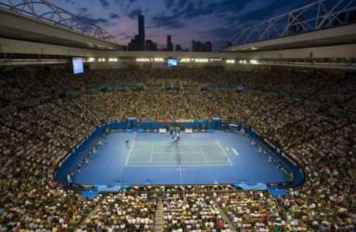
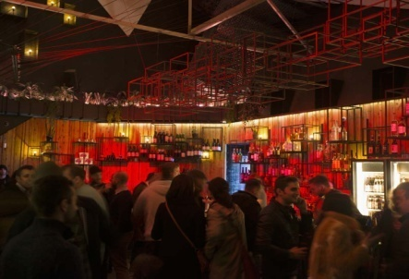
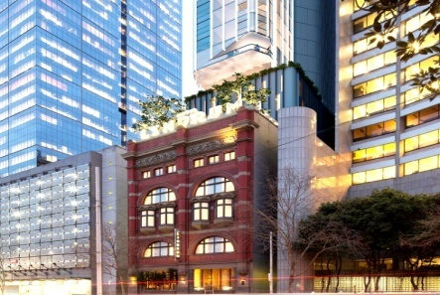
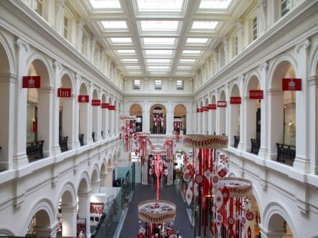
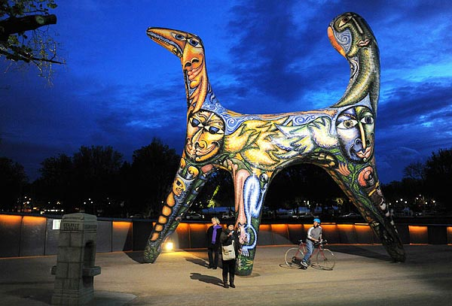
Creativity and culture are one part of the offer - focus of this work Melbourne's offering is broad, covering five sectors
Sports and recreation
Restaurants, cafes, bars
Environment and heritage
Shopping
Creative and cultural
“Creative industries are an evolving mix of sectors spanning arts, culture, screen, design, publishing and advertising. They cover disciplines as diverse as game development and graphic design, fashion and filmmaking, performing arts and publishing, architecture and advertising, media and music, comedy and craft. They include activities that are commercially-driven and community based, experimental and export-intense”
- Creative State, 2016
Focus of this work

Slide 9
Creative industries increasingly important to the economy Workers in the cultural and creative economy generate slightly more GVA* than the average Victorian worker
*GVA (gross value add) is the measure of the value of goods and services produced in an industry. It is used as a basic indicator of economic output.
The cultural and creative economy represents ~8% of Victorian employment ...
.. and its GVA share is growing relative to the Victorian economy
C/C (cultural and creative) economy employment as % of Victoria's working population over time
C/C economy GVA as % of Victoria's Industry GVA over time¹
Around one third of cultural and creative professionals work in design
CAGR^
(08-13)
%
%
7.4
7.5
7.5
7.5
7.7
7.8
7.6
7.7
8.0
7.2
7.1
7.4
1.8%
5.0%
2008
2009
2010
2011
2012
2013
2008
2009
2010
2011
2012
2013
(Vic average: 1.8%²⁾
Embedded
Support
Embedded
Specialist
Specialist & support
^CAGR (compound annual growth rate) is a measure of the (compounding) growth in value of an initial investment over time.
1. Industry GVA excludes GVA due to ownership of dwellings, which was approximately 9% of Victoria's GVA in 2013 2. National accounts data suggests 2.1% is Victorian growth rate, however data used by analysis indicate 1.8% - sourced from RDV GVA data Source: BCG analysis; Census data 2011 (ANZSIC and ANZSCO 4-digit codes for Victoria); Labour force statistics 6271.0.55.003 employment by industry group; GVA data sourced by RDV, ABS

Slide 10
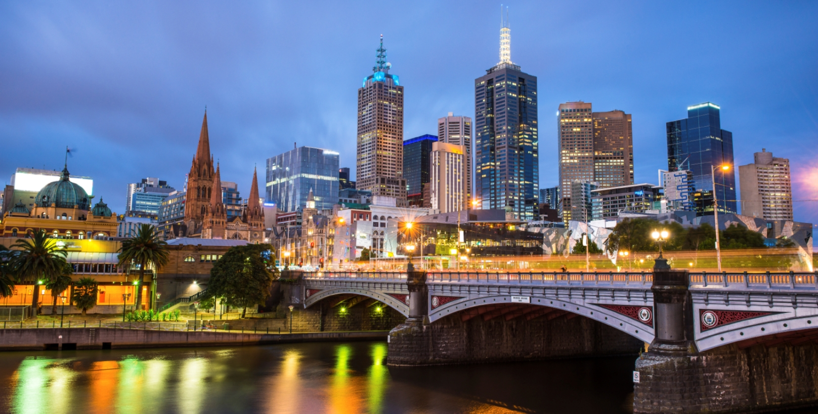









Melbourne offers diverse cultural and creative experiences
live music venues
549
most visited film centre in the world
1st
UNESCO World Cities of Literature
1/5
festivals featuring live music
350
largest games event in Asia-Pacific
1st
best fashion school in the world
9th
30% of the world's top ten contemporary art exhibitions 2015
3rd
largest comedy festival in the world
17m objects in Museum Victoria's collection
1st
largest film festival in Australia
19th most visited art gallery in the world
85,000 designers
Sources: Music Victoria: Victorian Music Fast Facts; ACMI: "Announcing ACMI X – Notes for Editors"; UNESCO: Creative Cities Network; Music Victoria: Victorian Music Fast Facts; Melbourne International Games Week: About Us; Business of Fashion: Global Fashion School Rankings 2015; The Art Newspaper, 31 March 2016; Melbourne International Comedy Festival, "Our Story"; Museums Victoria: About; Melbourne International Film Festival: About; The Art Newspaper, as reported in Melbourne Art Network, 7 April 2016, "NGV attendance figures rank alongside major international museums"; Wallis Strategic and Social Market Research for DEDJTR: Victoria Design 2015; World Cities Forum – Melbourne City Data

Slide 11






Melbourne seen as a cultural and creative city
Melbourne perceived by Australians as the country's leading cultural city¹
International travellers also perceive Melbourne as a creative city²
57%
think Melbourne is a great cultural city (Sydney 16%)
74%
agree that there are a lot of creative attractions, events & experiences in Melbourne
50%
think Melbourne is a great city for theatre (Sydney 31%)
69%
agree that Melbourne is a creative city
36%
think Melbourne is Australia's live music capital (Sydney 25%)
62%
think Melbourne is a better creative holiday destination than other cities in ANZ
think Melbourne has a reputation as the centre for design and innovation (Sydney 26%)
61%
think Melbourne is a better creative holiday destination than other cities in Asia
32%
1. Roy Morgan Research Brand Health Surveys (2015) 2. Global Traveller Survey (2016)

Slide 12
Creative experiences are one of top three reasons people visit This is true for both international and Australian visitors
Question: Thinking about your last trip to Melbourne, please rank the top 3 reasons why you visited
Creative experiences are the second most common reason for Australian visitors ...
... whereas internationals selected creative as the third most common reason for visiting
Domestic: Primary reason for visiting Melbourne (% of Australian visitors)
International: Primary reason for visiting Melbourne (% of international visitors)
Friends
Friends
Creative
Nature
Sports
Creative
Shopping
Shopping
Dining
Sports
Nature
Dining
Nightlife
Zoos
Zoos
Nightlife
Survey question 2.34 Thinking about your last trip to Melbourne, please rank the top 3 reasons why you visited: Visiting friends/family; Creative events, attractions, and experiences; Sports events and/or attractions e.g. Melbourne Cup, Australian Open, Melbourne Cricket Ground; Nature, such as beaches and botanic gardens; Restaurants and cafes; Bars and nightclubs; Opportunities to shop for leisure; Aquariums and zoos
Source: Global Traveller Survey (2016)

Slide 13
Broad range of cultural attractions attended by visitors Museum 2x as popular with international visitors than with Australians; NGV highly attended by both
Question: Which of the following creative activities did you attend? Response options are listed in the charts below
NGV, laneway graffiti/street art most popular attractions for domestic visitors
Melbourne Museum, NGV and public art most popular for international visitors
Domestic attendance at Melbourne's creative activities (% of Australian creative visitors to Melbourne)
International attendance at Melbourne's creative activities (% of international creative visitors to Melbourne)
NGV
Melbourne Museum
Laneway graffiti/street art
NGV
Indep. bookshop
Public art
Public art
Festival
Melbourne Museum
Indep. gallery
Festival
Indep. bookshop
Other theatre
Laneway graffiti
Indep. gallery
Victorian Opera
ACMI
Scienceworks
Other museum
Circus Oz
Other live music
MTC
State Library
MSO
Scienceworks
State Library
MTC
ACMI
Circus Oz
Other museum
MSO
Fashion event
Fashion event
Other live music
Victorian Opera
Other theatre
Survey question 2.42: Which of the following did you attend? Response options as per chart above, plus M Pavilion, Other Classical Music, Wheeler Centre, Malthouse Theatre, Other Dance Performance, and Other Creative Activity, which have been excluded from the chart as they were attended by <10% Many travellers attended more than one creative activity
Note: "Creative visitors" are those who reported participating in at least one creative activity on their trip to Melbourne. Many of the travellers who saw MTC, MSO, and/or the Victorian Opera will have done so at Arts Centre Melbourne.
Source: Global Traveller Survey (2016)

Slide 14
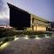
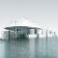
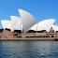
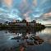
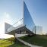
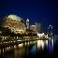
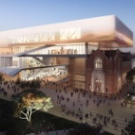
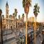
Competition for creative and cultural tourism is strong Governments around the world have been and will continue investing in cultural infrastructure
Brisbane: $290m
Gallery of Modern Art
(2006)
Abu Dhabi: $1.4b
Louvre Abu Dhabi (to open 2017)
Sydney: $0.6-1.9b
Redevelopment of Opera House and surrounds (2016-20)
Hobart: >$180m
Museum of New Art
(2011)
Hong Kong: $3.7b
West Kowloon Cultural District (currently under construction, M+ gallery opened 2016)
Singapore: $570m
Esplanade - Theatres on the Bay (2002)
Perth: $428m
Redevelopment of museum (to open 2020)
Adelaide: $260m New contemporary art gallery (under discussion)
Sources: Abu Dhabi: Faithful+Gould "The Louvre, Abu Dhabi" (quoted cost for construction only); Sydney: Create in NSW: The NSW Arts & Cultural Policy Framework (2015); 9 News (11 August 2016): "Sydney Opera House reveals what $202m upgrade will look like"; Brisbane: Stead (2015): The Brisbane Effect: GOMA and the Architectural Competition for a New Institutional Building. Hong Kong: West Kowloon Cultural District Authority Ordinance, cap. 601 (2008); Singapore: Singapore Government: History SG "Esplanade – Theatres on the Bay Opens"; Adelaide: The Advertiser, 27 August 2016, "Call for new site as Art Gallery of SA collection revalued at $1bn"; Hobart: The Australia, 4 October 2014, "David Walsh: from shy misfit to big-time gambler who founded MONA". Quoted cost includes building, fitout, and exhibits. Perth: ABC News, 31 July 2016, "New WA Museum blends old with new in 'bold, distinctive' design"; museum.wa.gov.au/newmuseum.

Slide 15
Agenda
Executive Summary
Context
Performance Index
Assessing Melbourne against best practice
Cultural travellers and trends
Strategic priorities
Next steps

Slide 16
The Performance Index comprises five metrics Collectively, the metrics measure a city's attractiveness as a global cultural and creative destination
A
B
C
D
Cultural and creative people want to study and work here
Cultural and creative sectors are supported
City offers quality cultural and creative experiences
Consumers are aware of these experiences
1
% Workforce in Cultural and Creative industries
2
% Excellent reviews on TripAdvisor
4
Social media "buzz" score
3
# Times listed in expert 'Top' lists
5
Cultural Traveller Survey ranking¹
E
The broader city environment is attractive
No metrics have been included for these dimensions because they less directly relate to the city's attractiveness for creative professionals and cultural visitors
F
The sector is well governed
Index measures performance against 38 cities globally
1. Cultural Traveller Survey: Over 1000 respondents from ten key future markets (Australia, New Zealand, China, India, Malaysia, Hong Kong, Singapore, U.K., France, United States) were asked to choose their top 10 cultural and creative destinations and subsequently rank them from 1 (most preferred) to 10 (least preferred)

Slide 17
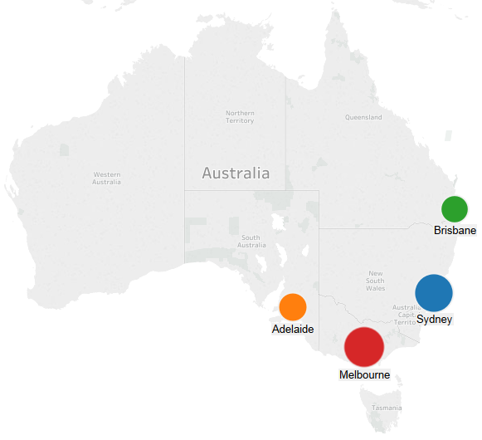
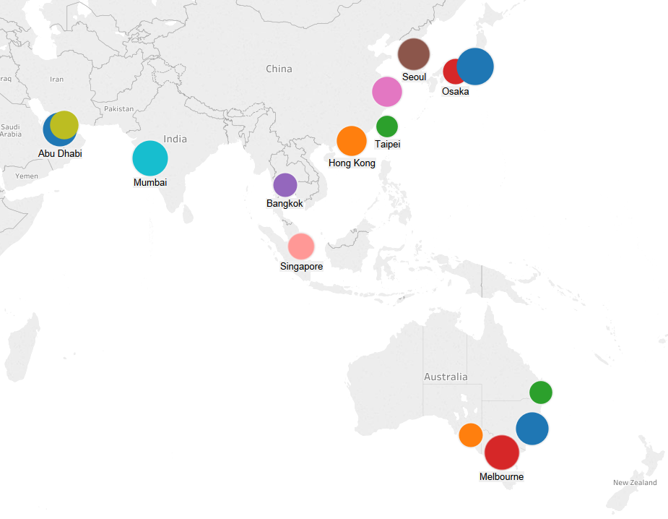
Melbourne currently ranks first in Australia, third in Asia ...
Melbourne ranks first of 4 cities in Australia
Melbourne ranks third of 14 cities in Asia
1
2
3
2
Tokyo (a key source for new trends in creative industries such as anime and manga, fashion and design) and Mumbai (home of Bollywood) lead in Asia, with a score of 31 and 28, respectively, followed closely by Melbourne with 27
3
Sydney, with an overall score of 24, is 3 points behind Melbourne (27)
1
1. Culture and the Future of Tokyo, 2014;
Methodology: The Performance Index scores and ranks 38 cities across 5 KPIs. The "best-in-class" city for each KPI is assigned a maximum score of 20; every other city is subsequently scored relative to this city. City scores for each KPI are then weighted and summed to generate an overall score and rank on the Performance Index.
Source: BCG Analysis

Slide 18
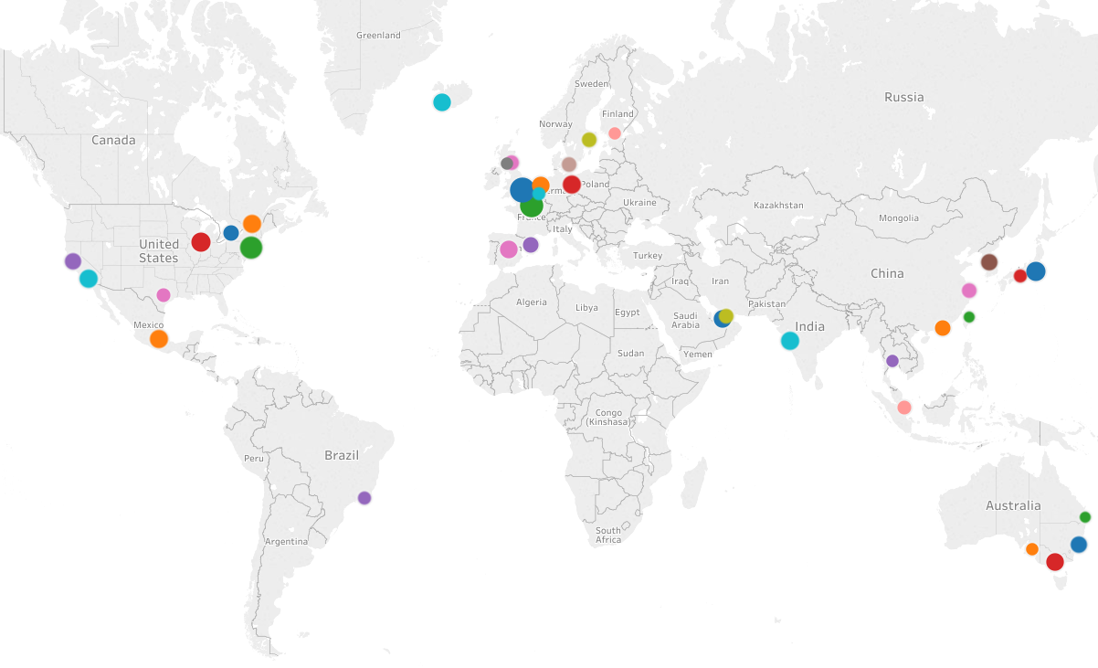
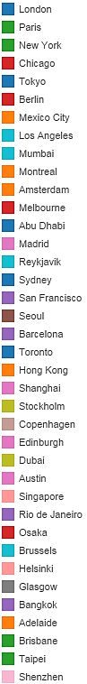
... and 12th out of 38 of the world's cultural and creative cities
London and Paris rank 1st and 2nd, with high scores of 53 and 46 of 60
Rank | City | Overall score (/60)
1 |  | 53
2 |  | 46
3 |  | 42
4 |  | 32
5 |  | 31
6 |  | 30
7 |  | 28
8 |  | 28
9 |  | 28
10 |  | 28
11 |  | 28
12 |  | 27
13 |  | 26
14 |  | 26
15 |  | 26
16 |  | 24
17 |  | 23
18 |  | 23
19 |  | 22
20 |  | 21
21 |  | 20
22 |  | 20
23 |  | 20
24 |  | 19
25 |  | 18
26 |  | 18
27 |  | 16
28 |  | 16
29 |  | 16
30 |  | 15
31 |  | 14
32 |  | 14
33 |  | 13
34 |  | 13
35 |  | 13
36 |  | 12
37 |  | 10
38 |  | 9
Top three cities are well ahead of the rest
Competition between cities ranked 4th to 15th is high; only 6 points differentiate Chicago (ranked 4th) from Reykjavik (ranked 15th)
Western Europe and East Coast U.S.A appear to be Cultural and Creative hubs
Methodology: The Performance Index scores and ranks 38 cities across 5 KPIs. The "best-in-class" city for each KPI is assigned a maximum score of 20; every other city is subsequently scored relative to this city. City scores for each KPI are then weighted and summed to generate an overall score and rank on the Performance Index.
Source: BCG Analysis

Slide 19
Agenda
Executive Summary
Context
Performance Index
Assessing Melbourne against best practice
Cultural travellers and trends
Strategic priorities
Next steps

Slide 20
Leading cultural and creative cities share six dimensions
A
B
C
D
Cultural and creative people want to study and work here
Cultural and creative sectors are active and supported
City offers quality cultural and creative experiences
Consumers are aware of cultural and creative experiences
E
The broader city environment is attractive
F
The sector is well governed by both government and arts organisations
Source: BCG experts; DEDJTR Project Control Group and Working Group; Arts Agency CEOs and Chairs; Interviews with Thought Leaders October – December 2016

Slide 21
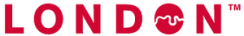



London, New York, Berlin and Paris display these dimensions
A
B
C
D
E
F
 | Cultural and creative people want to study and work here | Cultural and creative sectors are active and supported | City offers quality cultural and creative experiences | Consumers are aware of cultural and creative experiences | The broader city environment is attractive | The sector is well governed
 | Creative sector 12% of workforce 5 universities in the top 10 universities for performing arts | London local and central government spent £725m in 2011/12 on arts and culture | 857 art galleries 320 live music venues 241 theatres 215 museums | 19m international visitors 80% of visitors say 'culture and heritage' are the reason for visit | One of the largest urban transport networks in the world | City of London Cultural Strategy 2012-17
 | Creative sector 8% of workforce | Private contributions to arts US $800m+ in 2012; Public funding of the arts ~ US $320m FY15 | 613 art galleries 453 live music venues 420 theatres 143 museums | 13m international visitors 25m cultural tourists (domestic and international) | Walkable neighbourhoods, bike share and extensive public transport | New York Cultural Plan under development
 | Creative sector 10% of workforce | Local, City and Federal government spend ~€880m in 2014 on arts and culture | 180 museums 440 galleries | 5m international visitors | Flat and walkable, bicycle friendly supported by U-Bahn subway | Berlin Urban Development Concept 2030
 | Creative sector 9% of workforce | France Department of Culture and Communications' budget ~€3.6B p.a. | 1151 art galleries 430 live music venues 353 theatres 313 museums Louvre most visited gallery globally (8.5m p.a.) | 16m international visitors | Geographically condensed attractions supported by Paris Metro | 2010 Creative Paris Project
Source: World Cities Cultural Forum 2015; QS World University Rankings by Subject 2016 – Top 10 Performing Arts Schools in 2016: London Councils (June 2014) London Local Authorities Support for Arts and Culture 2014; MasterCard Global Destination Cities Index 2015: Mayor of London (2014), A cultural Tourism vision for London, 2015-2017; The City of London Cultural Strategy 2012-17; Center for an Urban Future (June 2015) Creative New York; NYC and Co (2013) New York City Tourism, a Model for Success; createnyc.org; Department of Cultural Affairs (2016) Report on the Fiscal 2017 Executive Budget; VisitBerlin (2014): Berlin visitor facts; Federal State of Berlin, Cultural Funding Report 2014; Berlin Urban Development Concept Berlin 2030: France Department of Culture and Communications 2017 Budget: Art Newspaper Visitor Figures 2015; www.creativeparis.info/en

Slide 22
Melbourne has strengths in offer and governance, underperforms in brand and marketing
A
B
C
D
Cultural and creative people want to study and work here
Cultural and creative sectors are supported
City offers quality cultural and creative experiences
Consumers are aware of these experiences
Education
Availability and cost of working spaces
Infrastructure and space
Branding
Employment opportunities
Financing for creation of art
Events and programs
Marketing
Cost of living
Networks and orgs to develop talent
Cultural, creative and artistic content
Information distribution
E
The broader city
environment is
attractive
Accessibility to other places
Intra-city connectivity
Enabling technology
F
The sector is well governed
Strategic management¹
Regulation
Mix of public and private funding
Cross-sector collaboration
Leadership
Clear strength
Mixed performance
Relative weakness
Includes policy analysis, planning, resource allocation, implementation and monitoring, evaluation and reporting
Source: BCG analysis; DEDJTR Project Control Group and Working Group; Arts Agency CEOs and Chairs; Interviews with Thought Leaders October – December 2016

Slide 23




Melbourne has some leading education institutions Number of art and design tertiary students is relatively high
A
Cultural and creative people want to study and work here
Melbourne has some of the world's best creative schools
Student tertiary participation in art and design is relatively strong
RMIT is ranked 16th in the world for art and design and in the top 10 for fashion
Swinburne is ranked 32nd in the world for art and design
VCA is ranked 37th in the world for art and design
Australian Ballet School is the national centre for elite classical dance training
Australian National Academy of Music is the national training academy for classical musicians
Amsterdam
Stockholm
Bogota
London
Melbourne¹
Tokyo
Sydney¹
Seoul
Madrid
Paris
Toronto
Montreal
Shanghai
Singapore
Hong Kong
# of art and design students per million people¹
Sydney and Melbourne numbers include students studying art and design at generalist universities only and therefore excludes the number of students of specialist art and design public institutions. Therefore the total number for these cities will be higher
Source: QS World University Rankings by Subject 2016 – Art and Design; Business of Fashion: Global Fashion School Rankings 2015; www.australianballetschool.com.au; www.anam.com.au; World Cities Forum Data 2016

Slide 24
Fewer VCE students are studying creative subjects Average decline of 2-3% across disciplines in last 10 years
A
Cultural and creative people want to study and work here
Potential drivers include schools' emphasis on STEM courses, possible encouragement of students to study professional courses and rescaling of ATAR scores for 'non-traditional' subjects
% of VCE students 2005, 2010, 2015
-3%
-2%
-2%
-3%
-3%
-1%
Studio Arts
Visual Communication Design
Literature
Design & Technology
Art
Music Performance
2005
2010
2015
%
Absolute percentage change 2005–2015
Source: Victorian Senior Secondary Certificate Participation and Completions 2005, 2010, 2015; Grade Distributions for Graded Assessments VCE 2015, 2010, 2005

Slide 25
Melbourne's design sector is growing, but building a culture of design appreciation will be crucial to maximising growth
A
Cultural and creative people want to study and work here
Businesses spent $4.3b on design in 2015, an increase of ~20% since 2008
Although the use and visibility of design remains relatively low
The use of design by local businesses remains relatively low
Only 44% of Victorian businesses make some use of design, compared to 70-80% in Europe
Melbourne's design graduates have one of the lowest employment rates at ~10%
Whilst Melbourne is the home of internationally recognised design icons (e.g. Aesop, Crumpler), the city lacks a major design employer
Melbourne lacks a major independent design institution that could support the education of business and the public in appreciating design
E.g. MoMA in New York or the Design Museum in London
Some Thought Leaders believe that the absence of a unified voice impacts the ability to promote design
There are close to 20 different design specialities and numerous industry associations across the Victorian professional design employment profile of 200,000
Victorian businesses spend on design $b
+19.4%
2008
2012
2015
Source: Wallis Market and Social Research (2015) Victoria Design 2015: Quantitative Report; Interviews with Thought Leaders October – December 2016

Slide 26
Rising housing costs may be driving creatives out of the city
A
Cultural and creative people want to study and work here
Creative professionals appear to be leaving the inner city
Median house prices have increased by one third in five years¹
Median price ($000)
Growth (%)
"People are getting priced out ... they have left Fitzroy and Collingwood, they're leaving Brunswick and they're heading to places like Reservoir and Castlemaine and Daylesford"
+35%
"The cautionary tale here is San Francisco. The influx of massive wealth has completely hollowed out the inner city. It's lost its creative buzz"
Sep
Dec
Mar
Jun
Sep
Dec
Mar
Jun
Sep
Dec
Mar
Jun
Sep
Dec
Mar
Jun
Sep
Dec
Mar
Jun
Sep
Dec
Mar
Jun
2010
2011
2012
2013
2014
2015
Melbourne is risking the "donut effect": a hollowing out of the city's cultural and creative buzz
Growth
Median price
1. Includes houses in the Melbourne metropolitan area, which is the 31 of Victoria's 71 municipalities that are located closest to the Melbourne CBD
Source: Domain Group; Interviews with Arts Agency CEOs and Chairs and Thought Leaders

Slide 27
Most cultural and creative businesses are small/medium These businesses rely on new graduates, emerging talent and affordable living/work spaces
B
Cultural and creative sectors are supported
Majority of cultural and creative businesses have 4 or less employees
Nationally, majority of businesses are in design, performing arts and print media
Breakdown of business in C/C industries in Australia (000s)
% of total
Design
81.7
60%
Non- employing
-2.2%
Fashion
Literature and print media
26%
1–4
-10.3%
Performing arts
Visual arts and crafts
85% of business have <4 employees
Broadcasting, electronic or digital media, or film
11%
5–9
+16.8%
Supporting activities
Other cultural goods manufacturing and sales
3%
20–199
+57.9%
Music composition and publishing
Museums
<1%
200+
Environmental heritage
Libraries and archives
2008
2013
0
10,000
20,000
30,000
0
10
20
30
80
90
Number of businesses in C/C industries in Victoria
Note: Total Victorian creative businesses in 2013 estimated at ~42,000
Source: ABS Satellite Accounts, Creative and Cultural Industries 2008-2009; BCG Analysis

Slide 28
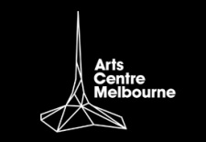
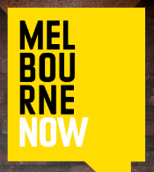


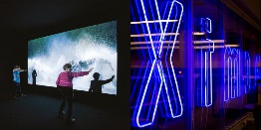
Many large arts organisations are supporting small/mediums A strong creative ecosystem relies on these linkages to encourage and incubate creativity
B
Cultural and creative sectors are supported
Example
Approach
Impact
Arts Centre Melbourne
Playking Travel Grants assist artists to establish creative connections and collaborations in Asia
Arts Wellbeing Collective provides mental health services for local artists
Commissioned 25 new works from small/mediums for AsiaTOPA
Six recipients in last six months
Under development: Will connect and support artists
0.5m funding to SME organisations
Melbourne
Now
NGV collaborated with 400+ local artists in 2013/14 to develop Melbourne Now — a major exhibition of contemporary Melbourne art
Exhibition received 753,000 visitors, which is 3x the average attendance of traditional shows
Collingwood
Arts Precinct
A social enterprise and contemporary creative precinct for small and medium creative organisations to work and collaborate
Under development: Site will provide 6,400m2 work space
Neon and Neon Next
Annual Neon Festival of Independent Theatre to showcase work of independent artists ran from 2013-15; Neon Next was established in 2016 to commission, develop, and present new works
In 2015, 7 independent theatre companies were supported by the festival; 6,000+ attendees
ACMI X
60 seat co-working space for individuals and small businesses working with the moving image
~80 individuals benefiting from the space
Source: www.artscentremelbourne.com.au; Melbourne Now Exhibition Report, 2014; www.creativevictoria.gov.au; Melbourne Theatre Company Annual Report (2015); www.acmi.net.au

Slide 29
Melbourne offers a diverse portfolio of spaces for artists Several Thought Leaders concerned about lack of manufacturing, rehearsal space
B
Cultural and creative sectors are supported
Number of spaces advertised on Creative Spaces by type, November 2016¹
Other spaces
City of Melbourne provides an additional 150 artist studios. There is also additional underutilised space in the CBD (57,749 m² of vacant storage/warehouse space and 165,772 m² of vacant office space)
Rehearsal spaces
Manufacturing spaces
Design studio
Co-working
Rehearsal
Visual Arts studio
Photo- graphy studio
Gallery
Dance studio
Music Rehearsal
Music perform. venue
Makerspace
Film editing
Manufact. space
Theatres
Share of total² | 31% | 25% | 24% | 22% | 20% | 19% | 14% | 12% | 12% | 7% | 4% | 4% | 3%
"There is a real need for space to make and experiment, most of the spaces available are for exhibiting or computer based content development"
"Not many spaces give you flexibility in how you use it. There's a lack of rehearsal spaces for smaller artists"
1. Based on number of advertisements at creativespaces.net.au, advertisements may be for one or more space. Total of 633 spaces advertised on Creative Spaces website in Melbourne Metro region, November 2016. 2. Percentages do not add to 100% as several spaces are multi-purpose
Source: creativespaces.net.au; City of Melbourne Arts Infrastructure Report, November (2016); Interviews with Thought Leaders October – December 2016

Slide 30
Workshop/studio and display space is declining
B
Cultural and creative sectors are supported
% Growth in space usage in City of Melbourne by type (2008- 2015)
Although total space has increased, creative spaces have declined
Residental Apartment
Common Area
House/ Townhouse
Performances, conferences, ceremonies
Office
Public Display area
Workshop/ studio
Total space
Med/high density residential accommod-ation
Indoor open space (bathrooms, foyers, stairwells etc.)
Detached or semi-detached residential accommod-ation
Theatres
Concert halls
Churches
Courts
Parliament
Conference facilities
Professional services space
Museums
Non-retail galleries
Exhibition space
Design studios
Workshops (watch making, appliances, cars etc.)
Creative spaces
Note: Analysis highlights high growth and creative spaces usage only, a total of 37 types of space usage mapped by City of Melbourne
Source: City of Melbourne, Census of Land Use and Employment 2008-2015

Slide 31
Working space is, on average, expensive for most artists
B
Cultural and creative sectors are supported
Average weekly co-working rent is ~85% of an artist's weekly earnings
And demand appears to exceed supply
$
Gap analysis conducted by the City of Melbourne's 2016 Arts Infrastructure Framework identified the following needs¹:
Live/work spaces
Affordable housing
Affordable co-working/office spaces
Performance and rehearsal spaces for small/medium sector
Gallery spaces for emerging artists and experimental work
Live music venue for 500-800 patrons
Waiting spaces for the City of Melbourne's Creative spaces program indicates demand exceeds supply
84 artists on the waiting list for Boyd Community Hub
30 artists on the waiting list for River Studios in West Melbourne
Searches for space on the Creative Space website all suggests unmet demand for live/work space, studio space, warehouse space and gallery space
Artists’ average weekly earnings²
Average co-working rent³
1. Based on an analysis of 10km radius from the CBD 2. Based on annual average earnings of $27,700 2. Based on an audit of co-working space conducted by Night Frank research 2016. Average co-working rent based on a weighted average of co-working space rent across CBD, City Fringe, Inner East, Southbank, North & West, Outer East and South East of Melbourne. Co- working space includes access to traditional office facilities and supporting infrastructure (this may include a reception desk, meeting rooms, break out areas, printing and high speed internet. (such as Hub Melbourne and York Butter Factory)
Source: Australia Council (2010) Do you really expect to get paid?; Night Frank (2016) Melbourne co-working insight; BCG analysis; City of Melbourne Arts Infrastructure Report, November (2016)

Slide 32
Benchmarks suggest Melbourne has strong infrastructure ...
C
City offers quality cultural and creative experiences
Cultural infrastructure assets (museums, live music venues, theatres and art galleries) per million residents¹
Melbourne has 800 venues, equivalent to 5th highest per capita
Amsterdam
Stockholm
Brussels
Paris
Melbourne
Sydney
NewYork
London
Edinburgh
Tokyo
LosAngeles
Madrid
Toronto
Montreal
Moscow
Istanbul
Seoul
Dubai
Total assets
544 | 364 | 504 | 2247 | 800 | 798 | 1629 | 1633 | 195 | 1350 | 1505 | 562 | 443 | 232 | 979 | 560 | 913 | 98
12 | 15 | 13 | 1 | 8 | 9 | 3 | 2 | 17 | 5 | 4 | 10 | 14 | 16 | 6 | 11 | 7 | 18
Assets rank²
1. Local population only (i.e. excludes visitors). 2. Based on total number of assets (museums, live music venues, theatres and art galleries)
Source: World Cities Culture Forum report (as at 2016); Demographia World Urban Areas, 2016

Slide 33
... driven by having the most live music venues
C
City offers quality cultural and creative experiences
Melbourne has relatively few museums …
It has the most live music venues ...
Number of museums per million residents
Number of music venues per million residents
Amsterdam
Stockholm
Brussels
Paris
Moscow
Edinburgh
London
Sydney
Montreal
New York
Los Angeles
Melbourne
Toronto
Madrid
Seoul
Dubai
Istanbul
Tokyo
Melbourne
Sydney
Amsterdam
Edinburgh
New York
Stockholm
Paris
Los Angeles
London
Tokyo
Toronto
Moscow
Montreal
Brussels
Madrid
Istanbul
Dubai
Seoul
… and relatively few theatres
... and an average number of art galleries
Number of theatres per million residents
Number of art galleries per million residents
Stockholm
New York
Amsterdam
Paris
Brussels
London
Los Angeles
Madrid
Sydney
Tokyo
Istanbul
Melbourne
Toronto
Moscow
Seoul
Montreal
Brussels
Amsterdam
Paris
London
Stockholm
New York
Edinburgh
Tokyo
Sydney
Madrid
Melbourne
Los Angeles
Toronto
Seoul
Dubai
Montreal
Istanbul
Moscow
Note: Local population only (i.e. excludes visitors)
Source: World Cities Culture Forum report (as at 2016); Demographia World Urban Areas, 2016

Slide 34
Many stakeholders see risk of losing "edginess"
C
City offers quality cultural and creative experiences
Melbourne risks losing its innovative, edgy culture ...
"We need to offer a greater diversity of experiences to different audiences"
"We are going backwards ... other places are becoming more proactive"
"Policy settings are more important than spending "
"Docklands broke Melbourne's cultural dynamic ... Cultural and creative expression is a total afterthought"
... while other cities become proactive, including Sydney
"Sydney is preserving affordable space ... and they are preserving it in the CBD"
"Sydney is really getting behind new ideas ... there's more support from Government for putting on a show"
"Sydney are more hungry ... they open their eyes wider and provide some money [to theatres]. Melbourne would rather open its cheque book for sporting events"
Source: Interviews with Arts Agency CEOs and Chairs and with Thought Leaders October – December 2016

Slide 35
Travellers more likely to recommend Melbourne after visiting Suggests increasing awareness through marketing could boost visitation
D
Consumers are aware of these experiences
75% will recommend Melbourne as a creative destination after visiting
Opportunity to clarify value proposition and market more effectively
Proportion of travellers likely to recommend Melbourne as a creative destination, before and after visiting (%)
"Melbourne lacks a clear value proposition for its cultural and creative offer... the proposition should be holistic, accounting for the diversity of the offer"
+24
"The current message is nowhere near good enough... we should communicate the city in a way that blows people away"
Somewhat likely
"Australia's tourism marketing focuses far too much on beaches and the Opera House... we need a campaign that shows our sophisticated, multi-layered offer"
Very likely
"We should target our priority markets, which includes China but also emerging areas like India"
Before
After
Some stakeholders point to lack of emphasis on cultural and creative assets; need for direct marketing overseas
Source: Global Traveller Survey (2016); Interviews with Arts Agency CEOs and Chairs and Thought Leaders (October – December 2016)

Slide 36
Greater social media following can associated with visitation Highlighting importance of channel for increasing awareness
D
Consumers are aware of these experiences
Social Media Followers¹
London
Paris
Dubai
New York
Lower social media followings for Asian cities could be because tourists to these cities use alternative social media platforms. For example, Chinese travellers are likely to use Weibo and WeChat rather than Facebook
Los Angeles
Chicago
Toronto
Barcelona
Abu Dhabi
Berlin
Amsterdam
Rio de Jan.
Sydney
Madrid
Tokyo
Melbourne
San Fran
Singapore
Stockholm
Mumbai
Shanghai
Hong Kong
Bangkok
Asian cities
Montreal
Taipei
Seoul
Non-Asian cities
Osaka
Brussels
Shenzhen
Number of international overnight visitors (2015)
1. Figure is the sum of (1) number of followers of the City's primary Facebook page; (2) number of followers on the City's Instagram page and (3) number of followers of the City's primary Twitter account
Source: Figures were drawn from each of the social media sites on 23 November 2016 and Mastercard Global Destination Cities Index (2015)

Slide 37
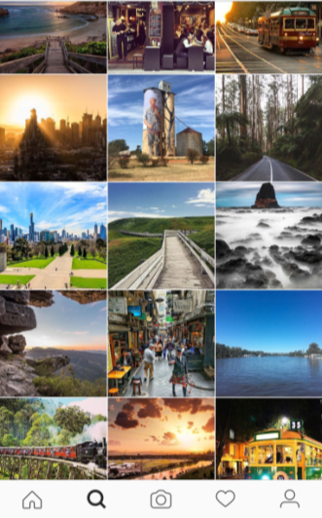
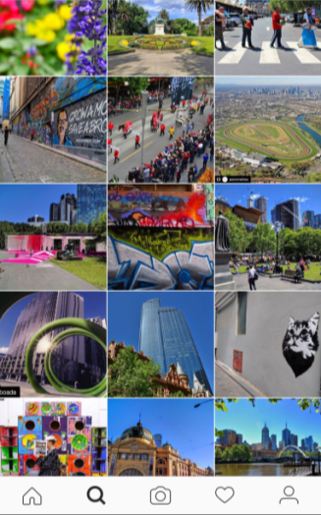
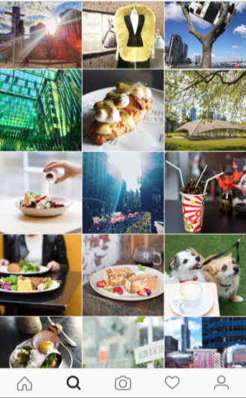
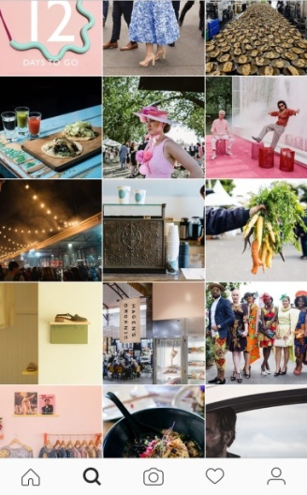
Melbourne: Culture, arts rank third most often on social media Based on review of content in 50 last Instagram posts
D
Consumers are aware of these experiences
 | Visit Melbourne 321k followers "Pics in and around Melbourne of places spaces and faces we love" | cityofmelbourne 123k followers "181 years young. Business, administrative, cultural and recreational hub of Victoria, Australia" | whatsonmelb 28.9k followers "City of Melbourne account. Melbourne moments can be unexpected and often unconventional" | Broadsheet 176k followers "Broadsheet is Melbourne's leading online magazine covering food and drink, nightlife, fashion, art, design and entertainment" | Total
Environment¹ | 46 | 37 | 19 | 8 | 110 (55%)
Food and wine | 2 | 2 | 20 | 24 | 48 (24%)
Culture and arts | 2 | 8 | 9 | 11 | 30 (15%)
Sport | 1 | 3 | 1 | 3 | 8 (4%)
Shopping | 1 | 0 | 1 | 4 | 6 (3%)
Date range | 9 Nov – 2 Dec | 9 Sep – 2 Dec | 22 Sep – 2 Dec | 10 Nov – 2 Dec
1. Includes urban architecture, except for laneways, which are included in Culture and Arts

Slide 38
Non-visitors are open to visiting Melbourne, believe better information is best lever to enhance attractiveness
D
Consumers are aware of these experiences
Question: How interested would you be in visiting Melbourne on a future holiday to Australia?
80% of non-visitors would consider visiting Melbourne in future ...
... better information and pre-packaged creative experiences could help draw visitors
How interested are you in visiting Melbourne on a future trip to Australia? (% of non-visitors)
What would make Melbourne a more attractive creative destination? (% of all participants)
A total of 80% of visitors are very or somewhat interested in visiting Melbourne in the future
Australian
International
1
Very
Somewhat
Neutral
Not very
Not at all
Better info
Events package
More diversity
Local/ Aboriginal
Source: Global Traveller Survey (2016) Question 2.24 options: Not at all interested; Not very interested; Neutral; Somewhat interested; Very interested. 2.39 Which one of the following would make Melbourne a more attractive creative destination? Better opportunities to engage with local and Indigenous arts and creativity; Greater diversity of creative events, attractions, and experiences; A new iconic building or large sculpture designed by a world-class architect and/or artist; A new modern art gallery; A new museum ; A new arts festival with a fantastic line up; An organised creative events package available to visitors (e.g. including a selection of concert, gallery, and museum tickets); More information available about the creative events, attractions, and experiences on offer, including smaller-scale ones such as independent galleries; Other. The options not shown in the chart above received <10% of vote.

Slide 39
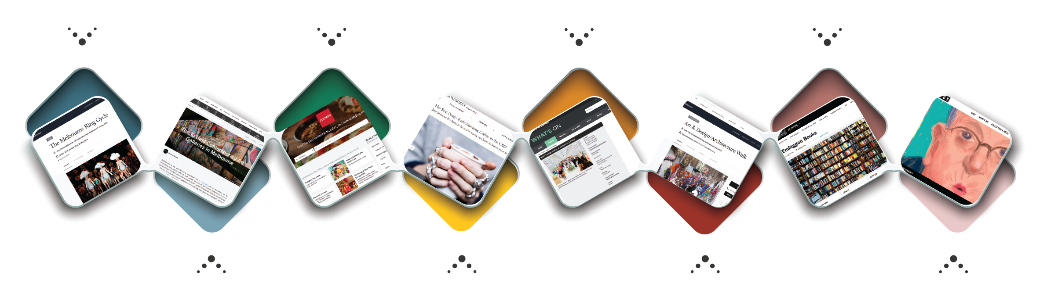
Information on "what's on" in Melbourne is highly fragmented A visitor may need six different sources of information to plan an (example) day
D
Consumers are aware of these experiences
ATTEND THE RING CYCLE AT THE ARTS CENTRE
www.visitmelbourne.com
FIND A PLACE TO EAT
www.zomato.com
www.visitmelbourne.com
CHECK OUT A DESIGN MARKET
www.thatsmelbourne.com.au
CHECK OUT AN INDEPENDENT BOOKSHOP
www.visitmelbourne.com
www.broadsheet.com.au
www.timeout.com
1
3
5
7
2
4
6
8
VISIT AN
INDEPENDENT GALLERY
www.visitmelbourne.com
www.timeout.com
www.culturetrip.com
GRAB SOME COFFEE
www.broadsheet.com.au
VIEW SOME PUBLIC ART
www.thatsmelbourne.com.au
www.visitmelbourne.com
VISIT NGV'S LATEST EXHIBITION
www.visitmelbourne.com
Source: BCG Analysis

Slide 40
Melbourne's transport infrastructure ranks highly But Free Tram Zone could be expanded and navigation made easier
E
The broader city environment is attractive
Melbourne ranks equal first on The Economist's transport rating ...
... but it could be more user-friendly and better connect cultural organisations
Hamburg
"The Free Tram Zone should be extended a couple of stops to Sturt Street and the MCG and the Melbourne Museum to allow locals and tourists to experience more of the city"
Melbourne
Singapore
Sydney
Adelaide
Amsterdam
Barcelona
Berlin
Copenhagen
Helsinki
Hong Kong
Paris
Stockholm
"It's really hard to get across the city, which makes it much less likely that people move around suburbs, because they have to go through the city"
Brussels
Chicago
Madrid
Montreal
Osaka
Tokyo
Brisbane
London
Los Angeles
New York
Seoul
Toronto
Abu Dhabi
Dubai
San Fran
"The [inner suburbs] feel like a world away from the city. There needs to be a unified, connected "string of pearls" around the city"
Santiago
Taipei
Reykjavik
Shenzhen
Shanghai
Rio de Jan.
Bangkok
Istanbul
Sao Paulo
Mumbai
Mexico City
The Economist Livability Index Transport Ranking¹
1. This metric provides an overall score for quality of road network, public transport, regional and international links, housing and provision of energy, water and telecommunications.
Note: Chart only shows 38 comparison cities
Source: The Economist, Liveability Index, Infrastructure, 2015; BCG Analysis; Interviews with Arts Agency CEOs and Chairs and with Thought Leaders October – December 2016

Slide 41
Melbourne has relatively low connectivity to the world Sydney receives almost twice as many international passengers as Melbourne
E
The broader city environment is attractive
Number of international air passengers moving through city, 2010-11 (m)
~2x
Number of international aircraft movements (2015, '000)¹
Sydney
Melbourne
Brisbane
Perth
Adelaide
68.5
42.3
29.1
21.7
4.3
1. Includes inbound and outbound.
Source: Department of Infrastructure and Transport (2012) Air Passenger movements through capital and non-capital cities to 2030-31: Research report 133; Department of Infrastructure and Regional Development (2015) Aviation - International airline activity 2015

Slide 42
Better collaboration with sports calendar could increase cultural participation in Melbourne
F
The sector is well governed
1.3m people attend major sporting events in Melbourne
Case Study: London leveraged 2012 Olympics to increase cultural tourism
Number of attendees at major sporting events, 2015 (000)
800
The city increased cultural engagement in lead-up and during Olympics
Ran exclusive 'limited edition' events
Set up a media centre to promote 600+ fashion, film, design culture and food events
Ran post Olympics global marketing campaign - London: Now see if for yourself - to convert 'viewers' to 'visitors'
Established Team London Ambassadors to ensure visitors got to where they needed to go and had the information they needed (similar to Melbourne's City Ambassadors)
600
400
704
200
319
297
0
Australian Open
Melbourne Cup
Grand Prix
Coincides with NGV Summer Series, Midsumma Festival
The week after the Melbourne Festival
The week after St Kilda Festival; close proximity to VAMFF
Source: 2015 Grand Prix Annual Report; Victoria Racing Club (2015); Tennis Australia, Australian Open 2015 – By the Numbers (2015); London & Partners - Strategy 2014-17

Slide 43
Summary: Melbourne's strengths and weaknesses
Strengths
Weaknesses
Perceived as a cultural and creative city because of the breadth of experiences available ...
Leading arts education institutions and strong creative industries ...
Reasonably strong infrastructure: per capita most live music venues, average number of galleries, lower number of museums) ...
Inner city easy to navigate; surrounding suburbs have unique identities ...
Blockbuster content, as well as a range of events and festivals to attend throughout the year ...
A well-governed sector with a clear strategic vision; Creative State and progressive regulation ...
... but the role of the creative and cultural brand is not clearly defined in the broader proposition; marketing
... but workshop, studio and exhibition space appears to be declining in the city, and affordability is low
... but existing assets need to managed more effectively, including with regard to maintenance, utilisation and storage
... but finding cultural and creative experiences and organising them is often fragmented to consumers
... but content quality is variable
Gaps in museums and contemporary art
Declining audiences, operational challenges at some festivals
Risk of losing "edginess", need to encourage risk-taking
... but unclear governance of some key projects (e.g. MAP); opportunity to collaborate more on key topics such as digital, Chinese consumers

Slide 44
Agenda
Executive Summary
Context
Performance Index
Assessing Melbourne against best practice
Cultural travellers and trends
Strategic priorities
Next steps

Slide 45
Cultural tourism accounts for 32% of visitors to Melbourne By 2025, cultural tourism could represent ~40% of all tourism
Forecast scenario: Visitors to Melbourne continue to grow at the same rate as they have on average, each year, from 2006-15 . Daily spend remains constant at 2015 level , and daily spend in Australia is equal to daily spend in Melbourne. Trip duration remains constant as at 2016
~40% of visitors to Melbourne could engage in cultural activities by 2025
International cultural visitors could be worth $2.5b by 2025
Visitors to Melbourne by origin and purpose (%)
∆ 2015-25
Estimated spend of cultural visitors to Melbourne p.a.($b)²
100
International general
0.6m
7
80
International cultural
1.2m
6
5.7
5
+8%
Domestic cultural
1.5m
2.5
Int'l cultural
60
4
3.9
40
3
2.7
1.5
Domestic general
1.4m
2
1.0
20
3.3
Domestic cultural
1
1.8
2.4
0
0
2015
P2020
P2025
2015
P2020
P2025
Note: "Cultural tourism" includes visitors who complete at least one arts and heritage activity on their trip to Australia. 2. Assumes that spend per night in Melbourne is the same as spend per night on trip to Australia as a whole, and that spending and trip length remains constant at 2015 levels. Assumes that growth in cultural visitors continues at average rate of 2006-15. Spend per visitor calculated by dividing total spend of each country in 2015 by total number of nights spent in Australia by visitors from that country in 2015. Number of nights spent in Melbourne per visitor estimated by using the average number of nights spent in Melbourne by cultural visitors in the Global Traveller Survey (2016).
Source: Tourism Research Australia: National and International Visitor Surveys; Global Traveller Survey (2016); BCG analysis.

Slide 46
Cultural visitors stay 25% longer than average
Average length of trip to Australia, 2015 (nights per visitor)
All visitors
Cultural visitors
+24%
All Int’l
France
India
UK
Hong Kong
China
Indonesia
Malaysia
USA
Singapore
NZ
Source: Tourism Research Australia (2015): International Visitor Survey.

Slide 47
Cultural visitors spend 20% more per trip on average
Average spend per trip to Australia, 2015 ($000 per visitor)
10
9.2
All visitors
8.7
Cultural visitors
8
+20%
7.6
6.9
6.6
6.5
6.4
6.0
6.3
6.3
6
5.9
5.9
5.6
5.3
5.2
4.5
4.7
4.5
4
4.0
3.8
2.7
2.2
2
0
All Int’l
China
France
USA
UK
Hong Kong
India
Indonesia
Singapore
Malaysia
NZ
Source: Tourism Research Australia (2015): International Visitor Survey; BCG analysis.

Slide 48
Internationals do more cultural activities the longer they stay But rate of engagement (activities per day) slows
On average, cultural engagement increases up until the seventh day of a visitors' stay
...but as trip length increases, average number of activities per day decreases
Average number of creative activities done in Melbourne (of visitors who completed at least one creative activity)
Average number of creative activities per day (of visitors who completed at least one creative activity)
Positive linear correlation between visit length and number of activities for first six days
<7 nights
7+ nights
Trip length (nights)
Trip length (nights)
Source: Global Traveller Survey (2016)

Slide 49
Younger visitors favour festivals and public art Other groups more likely to visit Melbourne Museum and street art
Question: Which of the following creative activities did you complete on your last holiday to Melbourne?
Ages 18-24
Ages 25-39
Ages 40-59
Ages 60+
Festival
Australian
International
Public art
Laneway graffiti/street art
Melbourne Museum
Independent bookshop
National Gallery of Victoria
Independent gallery
% visited
% visited
% visited
% visited
Generational preferences may change with age, i.e. today's 18-24 year old may choose museums over festivals in 2040
Source: Global Traveller Survey (2016)

Slide 50

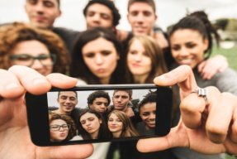

Three key trends that could impact Melbourne's offer
China | By 2030, a billion people in Asia will have the disposable income to travel Australia is one of Chinese travellers' top five "dream destinations"¹ China is already Melbourne's top source of international visitors (0.5m in 2015)² The number of Chinese visitors to Melbourne has increased 15% p.a. since 2006² Globally, creative attractions are taking steps to make themselves "China-ready"³
Millennials | By 2030, millennials will make up a large share of the tourism market⁴ In the coming years, millennials will have more disposable income Millennials are more interested in international travel and global cultural experiences than other generations Globally, creative attractions are targeting millennials in their marketing and customising their offer to suit millennials' preferences
Digital | Cities and creative attractions are leveraging new technology to reach consumers and make their offer more attractive Most top creative attractions and destinations now have a strong online presence, with a web page, social media accounts, and freely accessible online content Mobile apps are increasingly used to enhance experiences at creative attractions
1. BCG and Trip Advisor (2013): Winning the Next Billion Asian Travellers. 2. Tourism Research Australia: International Visitor Survey. 3. Los Angeles Tourism and Convention Board (2016): China-Ready Designation Requirements. 4. BCG (2011): Millennials Survey.

Slide 51
Agenda
Executive Summary
Context
Performance Index
Assessing Melbourne against best practice
Cultural travellers and trends
Strategic priorities
Next steps

Slide 52
Five strategic priorities to improve Melbourne's cultural offer
1
1a
1b
1c
Make culture a key part of the Melbourne proposition
Develop clear creative city messages
Target priority segments and travellers
Grow creative city awareness through investment, multi-faceted strategy (incl. social media)
2
3
4
Protect existing infrastructure
Optimise the current offer
Expand our offer
2a
Expand supply of creative spaces in under-served areas, address affordability
3a
4a
Build an integrated marketing, sales, reviews platform for creative and cultural activities
Upgrade and invest in new programming
2b
3b
4b
Improve maintenance, utilisation and storage of assets
Enhance connectivity between attractions
Upgrade and invest in new infrastructure to fill gaps
5
5a
5b
5c
Enhance governance
Use the Evaluation Framework to assess impact, viability and feasibility to build a pipeline of investments
Strengthen governance of Melbourne Arts Precinct
Improve agency collaboration

Slide 53
These priorities build on the Creative State Strategy
Area of weakness |  | Creative State Strategy |  | Strategic Priorities
Brand and marketing |  | Affordable advertising for arts orgs Innovative marketing for small/mediums International touring, events, collaboration |  | Develop clear creative city messages Target priority segments and travellers Grow creative city awareness through investment, multi-faceted strategy (incl. social media)
Availability and affordability of Space |  | Identify and unlock creative spaces in metropolitan and regional areas Guidelines to apply design principles to improve streetscapes, renew spaces, integrate art into new development |  | Expand supply of creative spaces in under-served areas, address affordability
Infrastructure maintenance |  | Invest in Collections Storage |  | Improve maintenance, utilisation and storage of assets
Information and connectivity |  | Shared data platform for program info |  | Build an integrated marketing, sale reviews platform for creative and cultural activities Enhance connectivity between attractions
Events and programs; cultural and creative content |  | Aboriginal training and employment in creative sector; greater engagement Support small/medium artists to develop, Commission groundbreaking works Business acceleration services Funding for small/mediums to build audiences, respond to market challenges Review role, delivery and operation of festivals, community events |  | Upgrade and invest in new programming Upgrade and invest in new infrastructure to fill gaps
Governance and collaboration |  | An annual summit and program of events for cultural and creative professions |  | Use the Evaluation Framework to assess impact, viability and feasibility to build a pipeline of investments Strengthen governance of Melbourne Arts Precinct Improve agency collaboration
8
1a
11
1b
33
1c
7
2a
19
9
2b
27
3a
3b
1
4a
4
4b
3
6
11
28
12
5a
5b
5c

Slide 54
Ideas should be compared against the Evaluation Framework Framework can support development of 10-year pipeline
4
Expand the offer
Initiative Evaluation Framework
A
Desirability
(measured by the Performance Index)
Does the idea make Melbourne a more attractive place for people to study and work in?
Does the idea enhance consumer perception of the quality of Melbourne's cultural and creative offer?
Does the idea enhance expert perception of the quality of Melbourne's cultural and creative offer?
Does the idea make Melbourne more attractive for locals and international tourists to visit?
Does the idea enhance Melbourne's international brand recognition and strength?
B
Viability
Does the idea provide an acceptable economic return?
Does the idea provide important non-economic benefits?
C
Feasibility
Is the idea technically, administratively and politically feasible?

